Slide 1

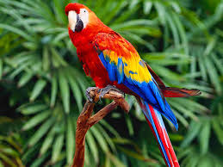
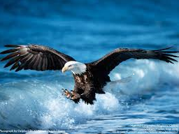

SENARAI ZON JPK PUTRAJAYA
SEMARAK EKSA WARGA CERIA
ZON 1
ZON 2
ZON 3
NURI
RAJAWALI
HELANG
(ARAS 7)
(ARAS 7)
(ARAS 8)

Slide 2
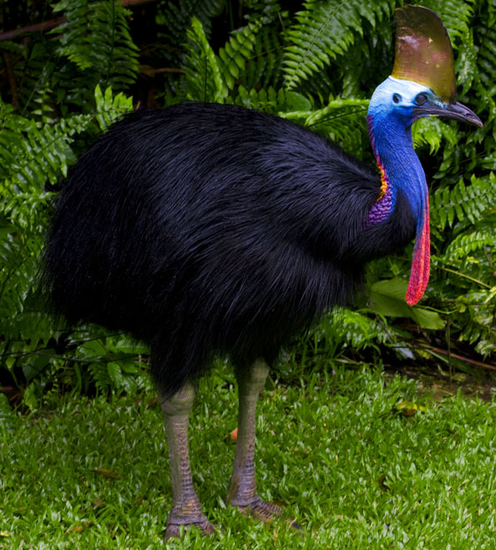
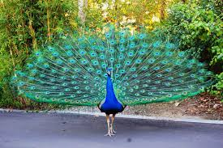
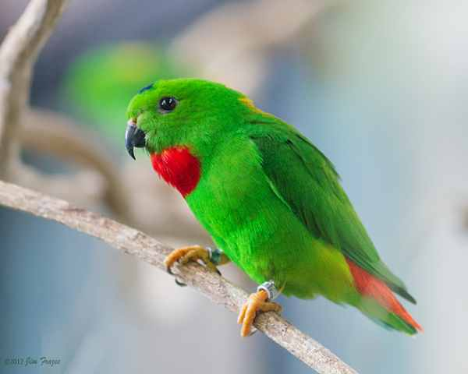

SENARAI ZON JPK CYBERJAYA
SEMARAK EKSA WARGA CERIA
ZON 4
ZON 5
ZON 6
ZON 7
KASAWARI
MERAK
SERINDIT
KENYALANG
(ARAS G)
(ARAS 1)
(ARAS 2)
(ARAS 3&4)

